Slide 1
Program synthesis for database-driven web applications
Rushi Shah
Turing Class of 2020
UT Program Analysis Research Group (UToPiA)

Slide 2
Motivation
Automating web application developer tasks created when the application’s underlying database schema is refactored
Notes:
Refactored for performance or maintainability reasons

Slide 3


Programmer Tasks
Code migration (PLDI’19)
Data migration (VLDB’20)

Slide 4
Code Migration
Migrator
Programming Languages Design & Implementation ‘19
Yuepeng Wang, James Dong, Rushi Shah, Isil Dillig
Notes:
Overview of results

Slide 5
Motivating Example
Instructor
Instructor ID
Instructor Name
Instructor Picture
TA
TA Id
TA Name
TA Pic
update addInstructor(id, name, pic)
INSERT INTO Instructor
VALUES (id, name, pic)
Notes:
Splitting the TA and Instructor Picture tables

Slide 6
Motivating Example
Instructor
Instructor ID
Instructor Name
Instructor Picture
TA
TA Id
TA Name
TA Pic
Instructor
Instructor ID
Instructor Name
Picture ID
TA
TA Id
TA Name
Picture ID
Picture
Picture ID
Picture
update addInstructor(id, name, pic)
INSERT INTO Instructor
VALUES (id, name, pic)
Notes:
Splitting the TA and Instructor Picture tables

Slide 7
Motivating Example
Instructor
Instructor ID
Instructor Name
Instructor Picture
TA
TA Id
TA Name
TA Pic
Instructor
Instructor ID
Instructor Name
Picture ID
TA
TA Id
TA Name
Picture ID
Picture
Picture ID
Picture
update addInstructor(id, name, pic)
???
update addInstructor(id, name, pic)
INSERT INTO Instructor
VALUES (id, name, pic)
Notes:
Splitting the TA and Instructor Picture tables

Slide 8
Motivating Example
Instructor
Instructor ID
Instructor Name
Instructor Picture
TA
TA Id
TA Name
TA Pic
Instructor
Instructor ID
Instructor Name
Picture ID
TA
TA Id
TA Name
Picture ID
Picture
Picture ID
Picture
update addInstructor(id, name, pic)
INSERT INTO Instructor
VALUES (id, name, UID0)
INSERT INTO Picture
VALUES (UID0, pic)
update addInstructor(id, name, pic)
INSERT INTO Instructor
VALUES (id, name, pic)
Notes:
Splitting the TA and Instructor Picture tables

Slide 9
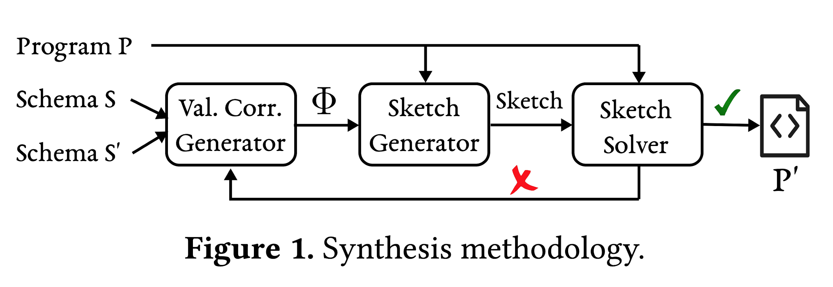
Synthesis Methodology

Slide 10
Sketch Generation
Instructor
Instructor ID
Instructor Name
Instructor Picture
TA
TA Id
TA Name
TA Pic
Instructor
Instructor ID
Instructor Name
Picture ID
TA
TA Id
TA Name
Picture ID
Picture
Picture ID
Picture
update addInstructor(id, name, pic)
INSERT INTO ??
VALUES (id, name, pic)
where ?? is the choice of which tables to insert into
update addInstructor(id, name, pic)
INSERT INTO Instructor
VALUES (id, name, pic)
Notes:
Splitting the TA and Instructor Picture tables

Slide 11
Sketch Completion
Naive solution :’(
Minimum Failing Inputs (MFI)
Efficiently prune search space

Slide 12
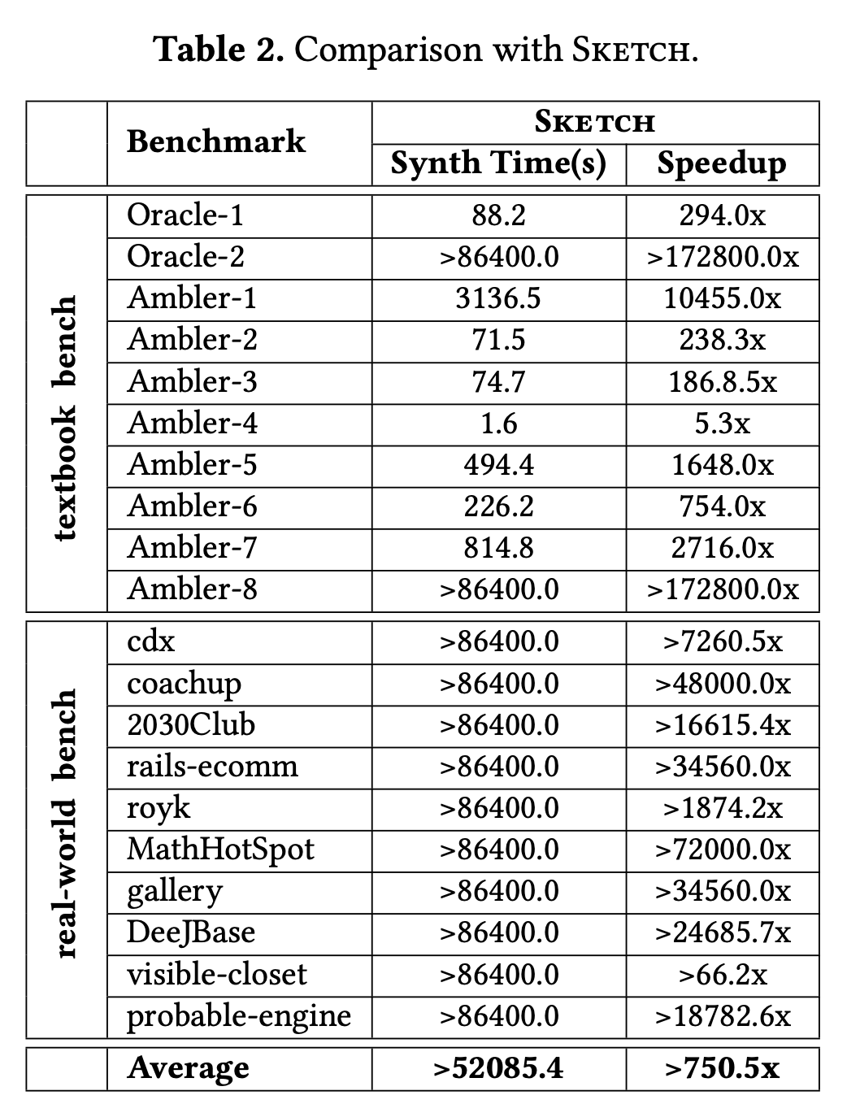
Sketch Completion - Evaluation
Reimplemented our synthesis solution into state-of-the-art tool called “Sketch”
(My main contribution!)
Notes:
MIT tool called Sketch which is a bounded model checker. Was super slow.

Slide 13
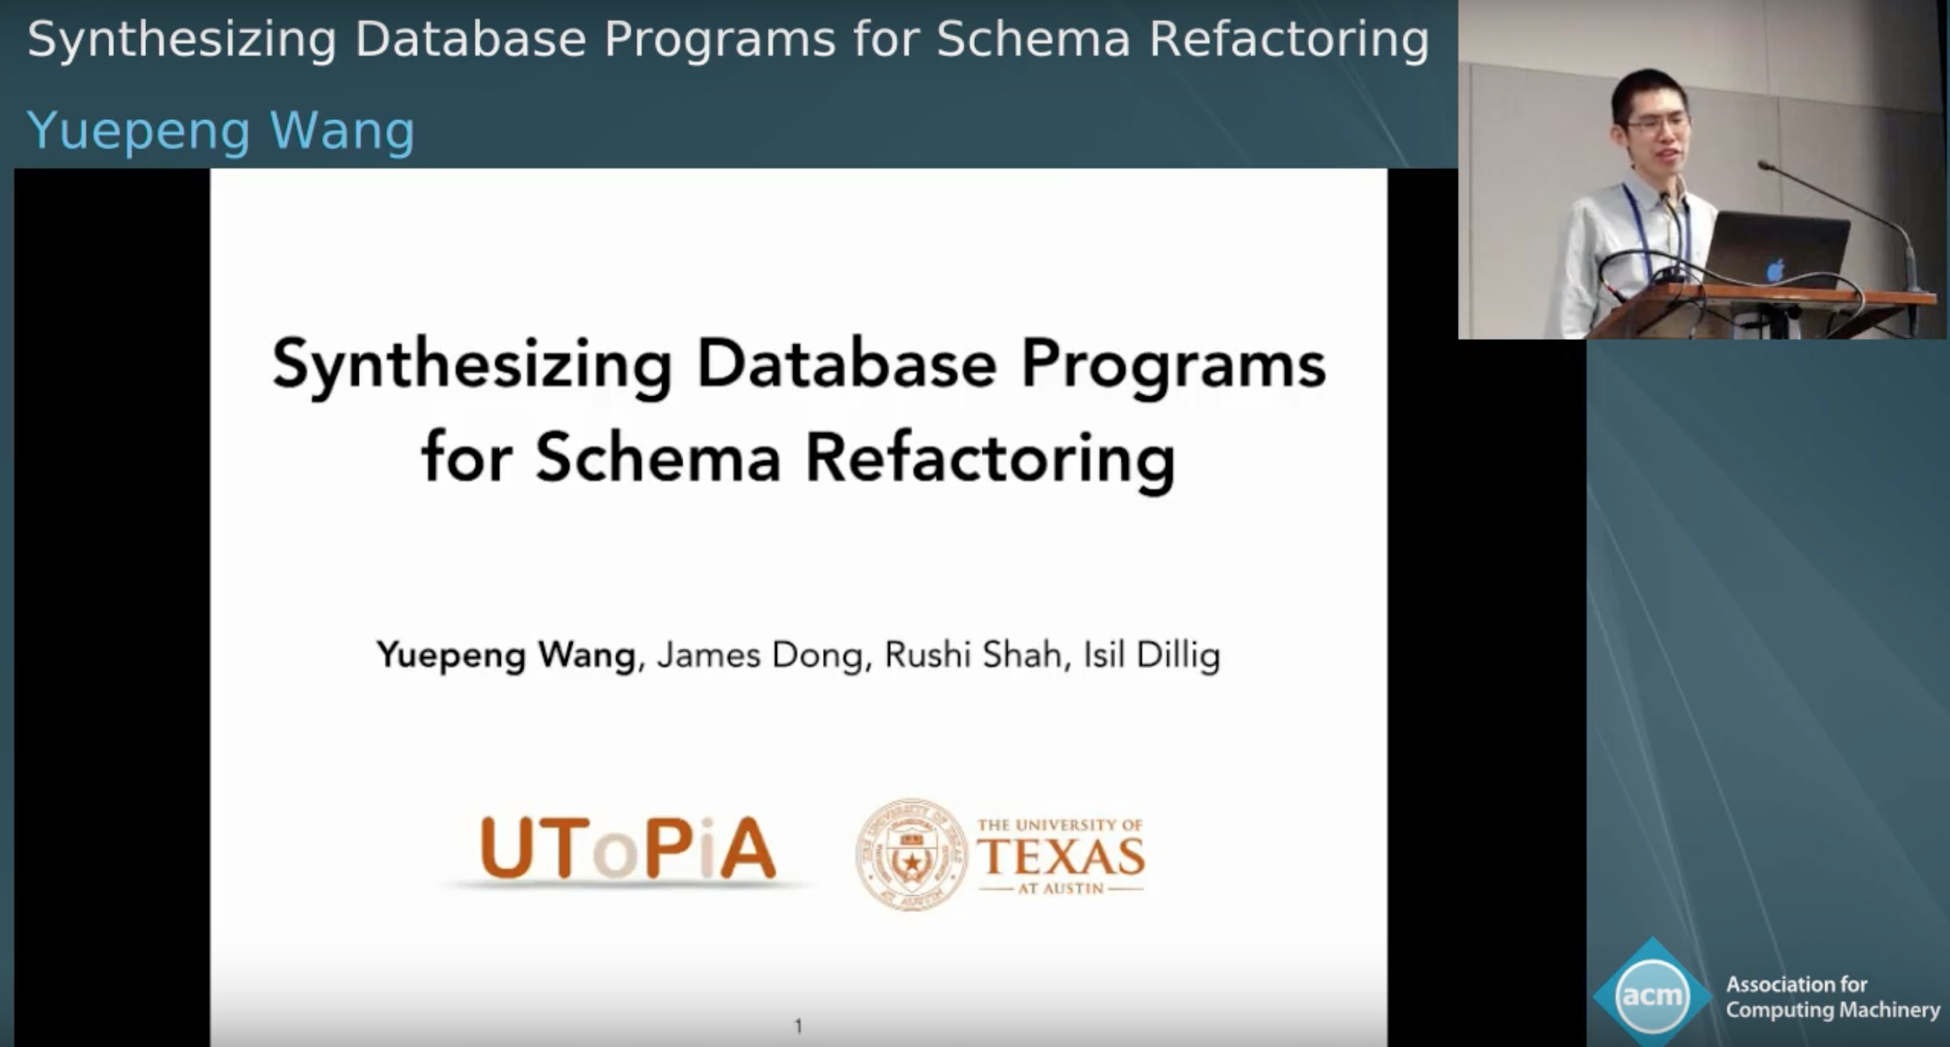
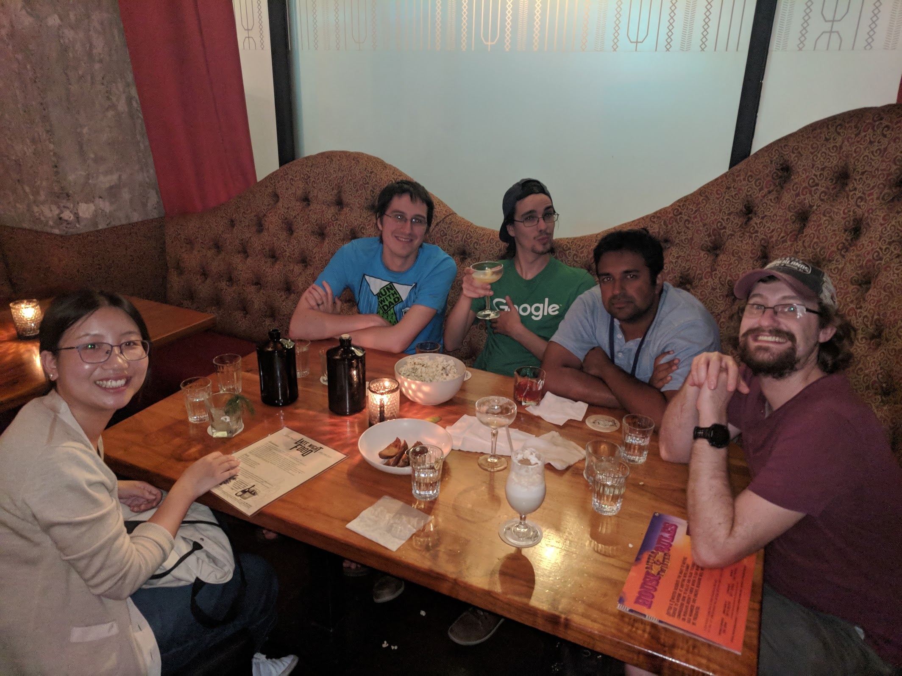
PLDI ‘19

Slide 14
Data Migration
Dynamite
Very Large Data Bases ‘20
Yuepeng Wang, Rushi Shah, Abby Criswell, Isil Dillig

Slide 15
Motivating Example
"businesses": [
{
"name": "Quiznos",
"checkins": [
"Mon-0:1", "Fri-21:1",
"Thu-22:1", "Mon-23:1"
],
[...]
},
{
"name": "My Thai",
"checkins": [
"Fri-17:1", "Wed-22:1"
],
[...]
}
]
Business(name, checkin_id, [...])
"Quiznos", "fk_quiznos", [...]
"My Thai", "fk_thai", [...]
Checkins(business_id, checkin)
"fk_quiznos", "Mon-0:1"
"fk_quiznos", "Fri-21:1"
"fk_quiznos", "Thu-22:1"
"fk_quiznos", "Mon-23:1"
"fk_thai", "Fri-17:1"
"fk_thai", "Wed-22:1"

Slide 16
Datalog Background
Facts
parent(rahil, arjun)
parent(arjun, divya)
Rules
child(Y, X) :- parent(X, Y)

Slide 17
Datalog for Data Migration
Example
parent(bill, mary)
parent(mary, john)
child(Y, X) :- parent(X, Y)
Rules represent the migration relationship
LHS from target schema, RHS from source schema
Facts are rows in the database to be migrated

Slide 18
Motivating Example
Input
Source and target database schema
Source: parent(adult, kid)
Target: child(kid, adult)
Input/Output Example
parent(rahil, arjun) should give child(arjun, rahil)
Source database instance
parent(rahil, arjun)
parent(arjun, divya)
[...]
Output
Target database instance
child(arjun, rahil)
child(divya, arjun)
[...]

Slide 19
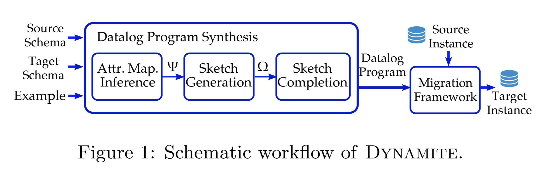
Dynamite Overview

Slide 20
Datalog Program Synthesis
Similar synthesis methodology
Generating Datalog program sketch
Sketch completion
Minimal Distinguishing Projection (MDP)
Efficiently prune search space
Basically “minimum failing inputs” from Migrator

Slide 21
Migration Framework
(My main contribution!)
Actually performing the migration using the Datalog program on real-world databases is non-trivial
IMDB, Yelp, DBLP, etc. are “V E R Y L A R G E”
Documents were recursively nested
Supporting relational, document, & graph database formats
Database instance to Datalog facts and vice versa

Slide 22

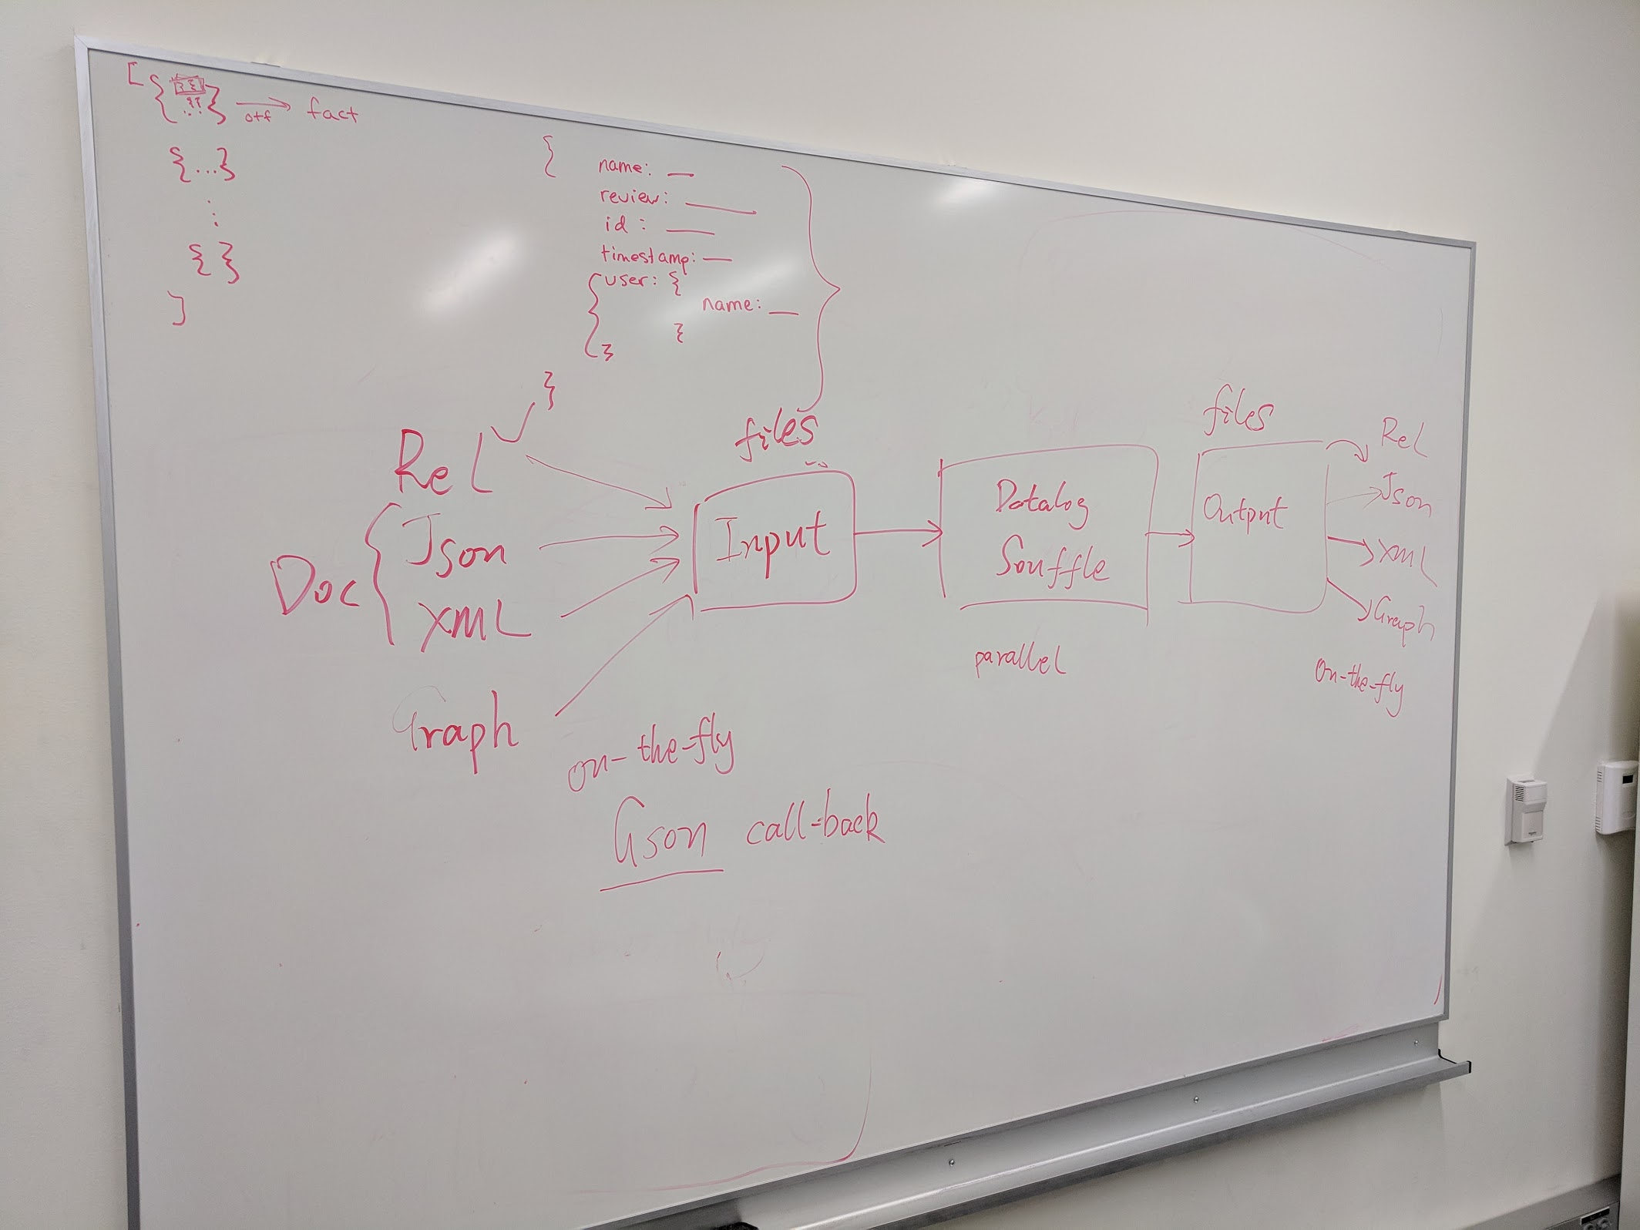
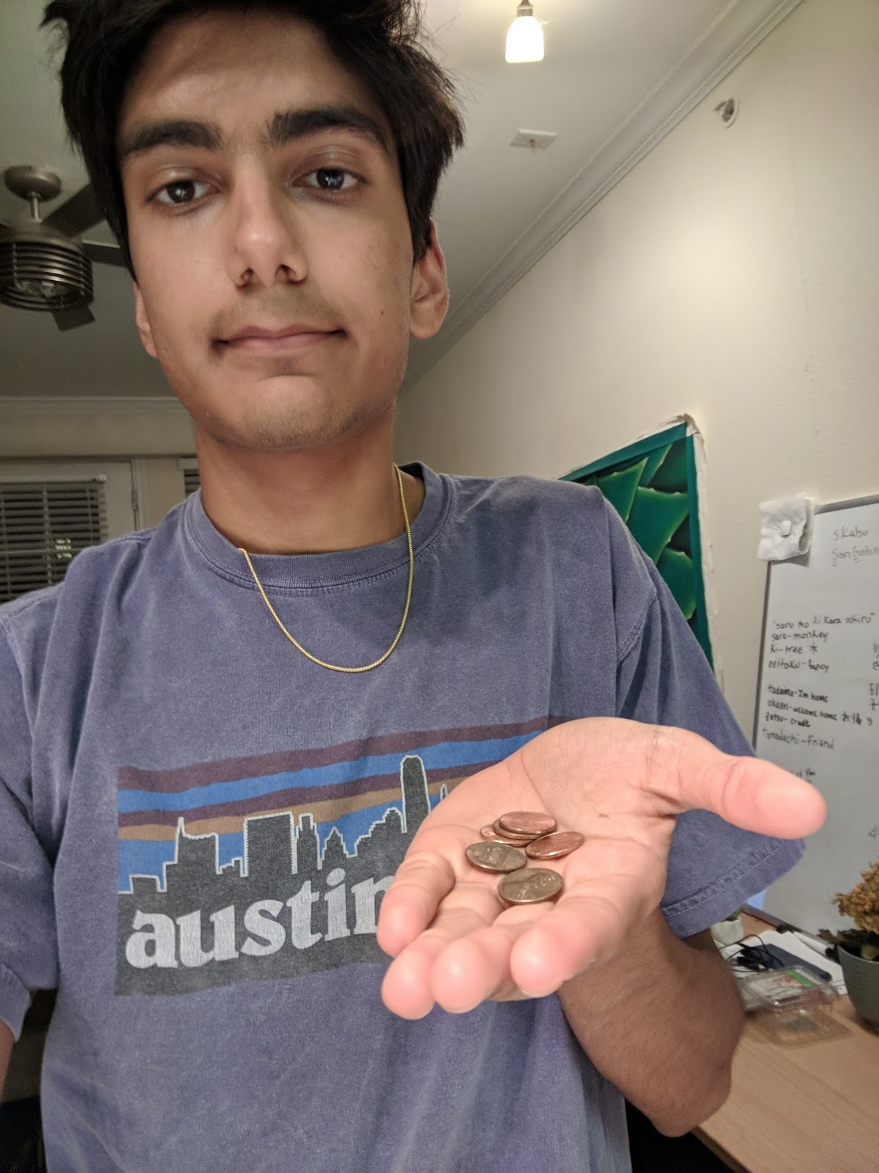


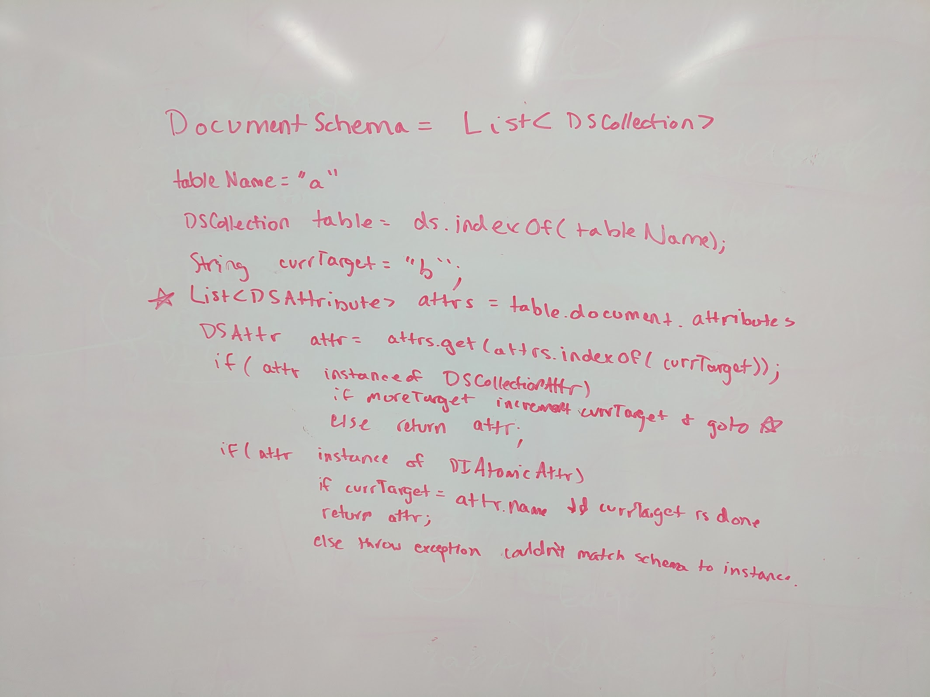

Slide 23
Conclusion
Failed previous projects
SyPet -> Pythagoras
Database Model Checker
Start sooner rather than later so you can pivot
Computer Security !?
Everybody feels like they don’t even really understand their own field
At least I do …
Hook ‘em 🤘🏽

